Slide 1

M.E. SEMINAR ON
The Secure Data Transmission Through Digital Protection Wall Over Wireless Media
Presented by
Ms.Devika R.Gawande
Guided By: Dr. S. W. Mohod
Co-guide: Prof. A.S. Utane
Department of Electronics &Telecommunication Engineering

Slide 2
Abstract
The secrecy and security of information has always been important to people, organizations and goverments.
This makes security issues top priority to an oraganization dealing with confidential data.
Whatever methods we choose for security purpose the degree of security is major concern.

Slide 3
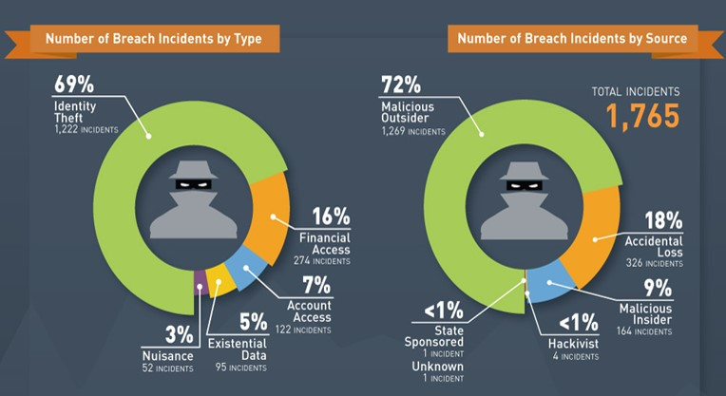
Motivation:
The motivation behind developing such type of system is the increasing no. of incidences of loss of data over wireless media.

Slide 4
Literature survey:
Conventional encryption alone still leaves many problems unsolved.
Protection from the encryption vanishesh once the data is decrypted.
It does not guard from the vulnerabilities emarges from poor system infrastructure.

Slide 5
Confendential communication over public network can be done using digital media such as text,audio,image and media over internet.
But simply using cryptography is not adequate.
Thus additional security layer is needed to the ciphered text.

Slide 6
Pixel value differencing
In this process of embeding secrete message involves partition of carrier into two overlapping blocks of pixels.
And diffrence value is calculated from the values of two pixels in each block

Slide 7
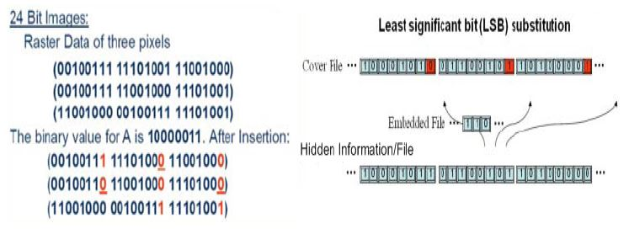
Least significant bit modification
It is most widely used technique to hide data.
Its relative easiness to implement makes it popular.

Slide 9
Objective
To hide large ammount of data behind the carrier.
To compare the performance analysis of proposed scheme with existing one.
Performance evalution of proposed algorithm in terms of embeddability criteria,computational time,hiding capacity etc.
To maintain dependability between secrete data and carrier.
To create unbreakable wall for stagnalyzer while extracting data.
To maintain carrier percepyual quality

Slide 10
Introduction:
There is need to develop e a system that will securely transmit data confendential data over wireless media.
This system makes the use of Data Hiding techniques to set the protection wall over secrete data.

Slide 11
Data Hiding
The term data hiding used here refers to either produce data to be hidden or making the existance of secrete information unnoticeble.

Slide 12
Proposed methodology
Algorithm-Sender side
START
INPUT CARRIER MEDIA
SELECT SECRETE DATA
CONVERT IT INTO BINARY FORMAT
SELECT DIGITAL PROTECTION WALL
EMBED SECRETE DATA INTO PROTECTION REGION
STOP

Slide 13
RECEIVER SIDE-
START
RECEIVED CARRIER MEDIA
SELECT PROTECTION WALL
EXTRACT SECRETE BINARY DATA
CONVERT SECRETE BINARY DATA TO ASCII FORMAT
STOP

Slide 14
Expected Outcome
The expected outcome of the work is the resultant carrier object with hidden data which was embed in order to provide secrecy.

Slide 15
THANK YOU

